Slide 1
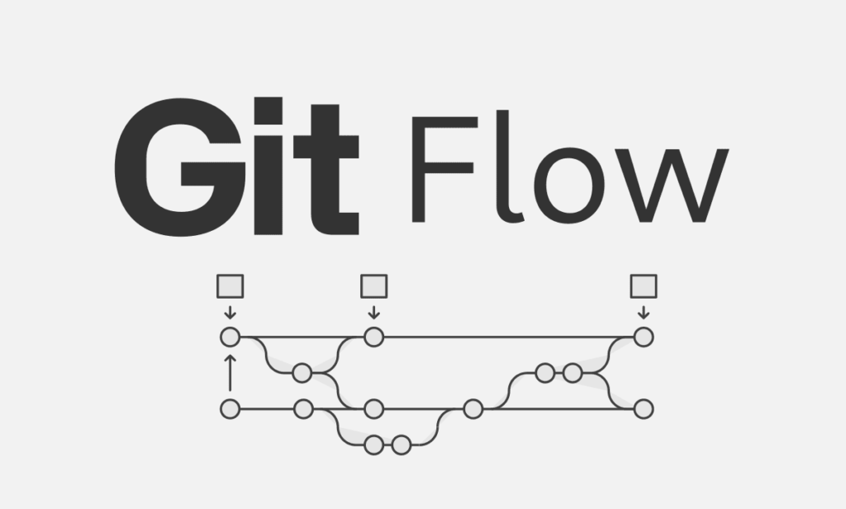
Lecture 11: Git Collaboration and Workflows
Eng / Youssef khaled
BackEnd Roadmap

Slide 2
Collaboration with Git
- Remote Repositories
- Adding a remote repository (`git remote add`)
- Fetching changes (`git fetch`)
- Pulling changes (`git pull`)
- Pushing changes (`git push`)
- Resolving Conflicts
- Identifying and resolving merge conflicts
- Using tools and commands to resolve conflicts

Slide 3

Git Workflows
Common Workflows
- Centralized Workflow
- Feature Branch Workflow
- Git Flow Workflow
Best Practices
- Commit messages conventions
- Regular commits and updates

Slide 4

Hands-On Exercise
- Collaborate on a shared repository
1
- Practice pulling, pushing, and resolving conflicts
2
- Experiment with different Git workflows
3

